Slide 1




OSM-GB
Amir Pourabdollah
Jeremy Morley, Steven Feldman

Slide 2

Some Research Questions
Will automated rules based processes improve quality?
Will formal QA increase confidence/authority?
Will improved QA & confidence & ease of access increase contribution?
Can “professional” contributors be “motivated” to fill in gaps?
What benefits arise from conflating OSM with Ordnance Survey data?
Notes:
Apply rules based QI processes to OSM - identify possible errors & after some experiment automatically correct some errors. Enhance data through logical processes e.g. speed limits. Offer “improved” dataset back to the main OSM database (probably as a basis for further inspection prior to incorporation).
By making the data available via OGC WS, it is hoped that public sector users in CG & LG will be encouraged to experiment with OSM and identify potential use cases for OSM that are not met by current PSMA data.
Encourage prof users who have a great deal of local knowledge to become contributors to OSM. In the longer term it may even be possible to encourage these users to incorporate contributing to OSM as part of their routine workflows.
Explore win/wins with Ordnance Survey data – Open & Premium

Slide 3
3 Phases
Set up infrastructure and web services
Develop rules based improvements
& Public sector use cases
Explore conflation with OS OpenData

Slide 4
Links and Communications
Central Government
Ordnance Survey
DEFRA
Councils
Surrey Heath Borough Council
Mole Valley District Council
Warwickshire County Council
Cambridgeshire County Council
Industry
Astun Technology
Cadcorp
Snowflake
Pitney Bowes
Total Ren Solutions (serving Leicester City Council)
Geolink Consulting
ESRI
TEP (Serving Home and Community Agency)
OPTARK (Distribution Software Developer)
OSM Community
Individuals
OSM wiki
OSMGB Blog and Twitter
Academic
THE ISSUE Project
Feedbacks from Lancaster University
UoN School of Electrical Engineering (Mobile Network GIS)
Through ELOGeo
Others
National Trust
OGC
Feedbacks from Metropolitan Police
Overseas
Committee for Geographic Names Australasia
The University of Melbourne
Delft University of Technology
UoN Malaysian Campus

Slide 5
System Design
Initial user group meeting + user discussions
Professional Users’ Requirements
Raster and Vector Maps
Coordinate Reference System
OGC Compliance
Consistent Access to National Open Maps
Multiplicity of Layers
Frequent Updates
Quality Check and Fix
Orchestration between the available resources
OSM ingestion
Radius Studio
Databases
Open-source tools
Web resources and open data

Slide 6
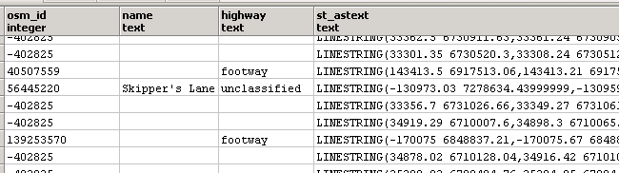
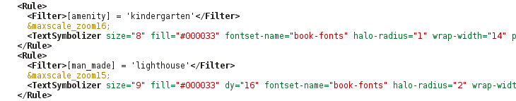
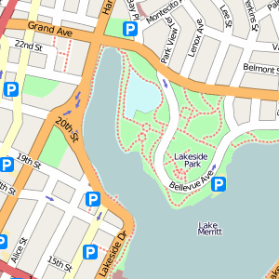

Outside
Server 3
Linux
OSM Update
OSM
OS Open Data
Import Tools:
OSM2PGSQL
OSMOSIS
SHP2PGSQL
PostGIS
(Geofabrik)
Server 1
Windows
Server 2
Linux
Conversion Tool:
OGR2OGR
WikiMedia
WordPress
PostGIS
Python Script
Infrastructure
Mapnik Style-sheet (XML)
Oracle Spatial
GeoServer
Mapnik
OSM Community
Radius Studio
GeoWeb
Cache
Mapnik OGCServer
Web Interface
Web Services
Raster Maps
Apache
Web Server
Workflow Engine
Tile Server
(renderd)
Apache Web Server
WFS
WMS-C
WMS
WTMS
Web
Services
Client Side
OSM Editors:
JOSM, Potlatch, ...
Desktop GIS:
QGIS, ArcMap, ...
Web GIS:
OpenLayers, ...

Slide 7
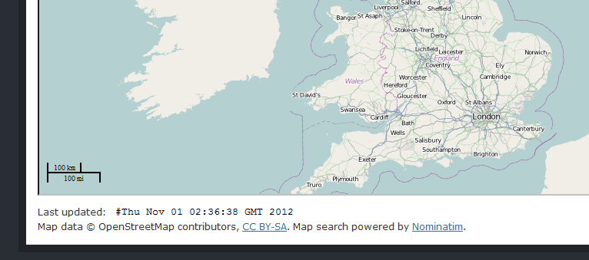
Daily (or Nightly) Update
Server 3
Make backup +
Update raw OSM data
Starts: 1:30 am
Lasts: 1 hour
Server 1+3
Transfer selected data + Process
Starts: 3 am
Lasts: 1.5 hour
Transfer back processed data + Update OSMGB data
Starts: 5 am
Lasts: 10 min
Server 1+3

Slide 8
Optimized Update
Apply changes-only updates from OSM Replication Website (daily)
Saves about 2hours daily
Apply rules/fixes on “selected” features instead of processing all OSM.
All the buggy features from yesterday
And all features in their proximity (currently 20m)
Newly added/changed features
And all features in their proximity (currently 20m)
Saved time depends on rule-base (currently saving 2 days for each processing round)

Slide 9
Data Update Workflow
OSM Update
Start
Data flow
Database
Task
Linux Server
Data Backup
Revert Previous OSM-GB Changes
PostGIS
Update Changes
Export the “selected” features from PostGIS to Oracle
Windows Server
Oracle Spatial
Radius Studio: Apply
The rules
Apply the changes back to PostGIS
End

Slide 10
OGC Web Services
WMS
Layers
Land (5 sub-layers)
Water (12 sub-layers)
Buildings (7 sub-layers)
Power (3 sub-layers)
Boundaries (4 sub-layers)
Transportation (38 sub-layers)
Places (11 sub-layers)
Amenities (6 sub-layers)
WMTS
256x256 flatten tiles in png
WFS
Separated by Points, Lines and Polygons
Serving geometry + attributes
WMSC
Quick WMS service (single layer)
WMS/WFS for Bugs
Serving the detected bugs (Points, Lines and Polygons)
WFS for OS OpenData
VMD (20 layers)
Meridian-2 (19 layers)
CRS
British National Grid (EPSG:27700)
Lat/long (EPSG:4326)
Google Mercator (EPSG:900913)
Vector Formats:
GML 2, GML 3.1, GML 3.2, GeoJSON, ShapeFile and CSV
Raster Formats:
png, pdf, kml, kmz, geotiff8, gif, jpeg, png8, svg, tiff, tiff
Tested on
OpenLayers
QGIS
ArcMap
Mapinfo
Cadcorp

Slide 11
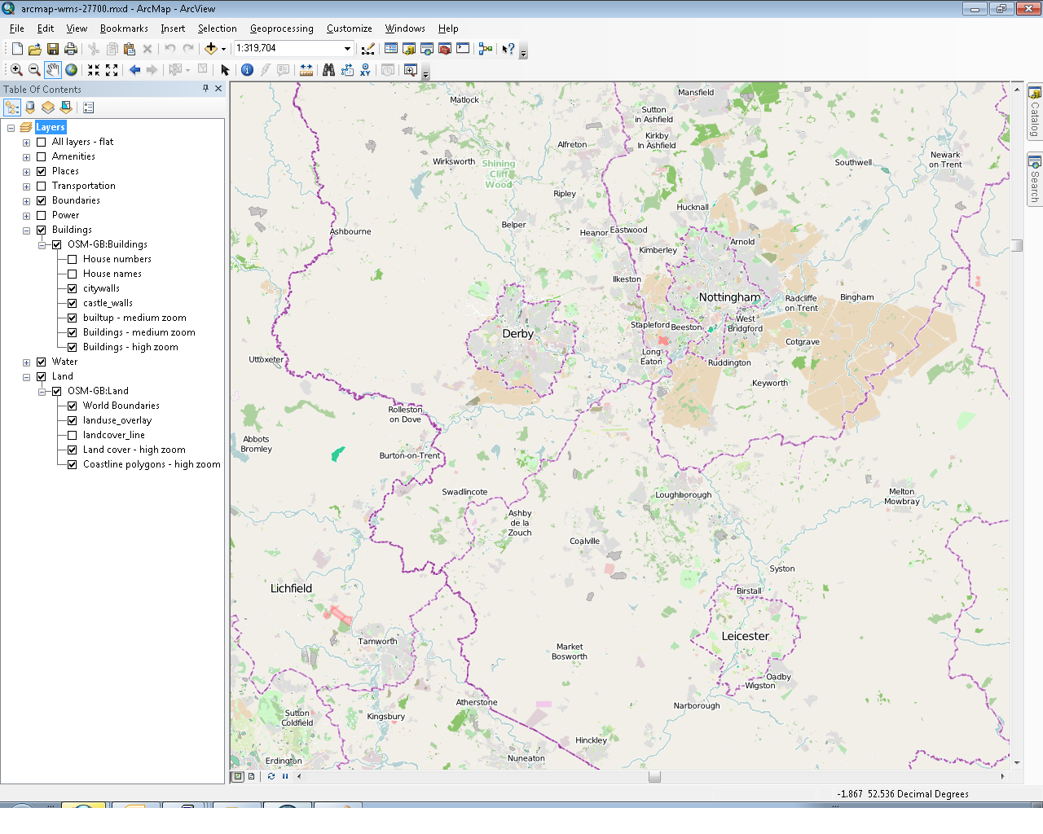
Multi-layered WMS in Desktop GIS - ArcMap

Slide 12
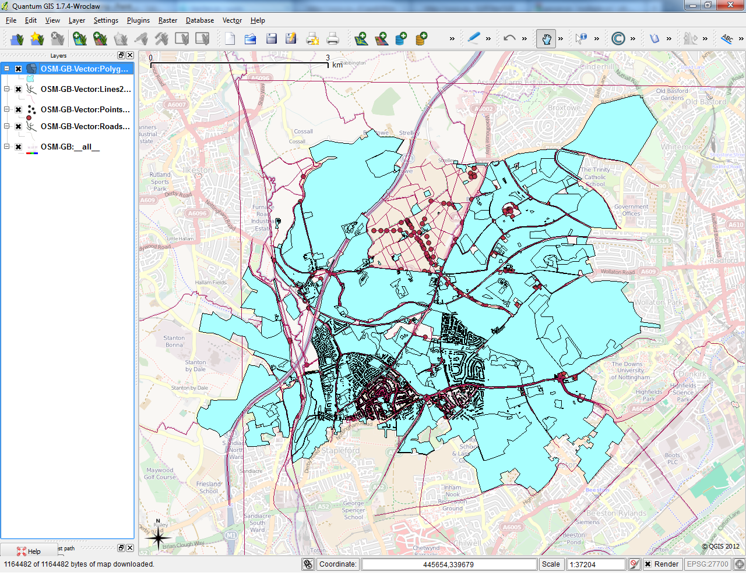
Using WMS/WFS in QGIS

Slide 13
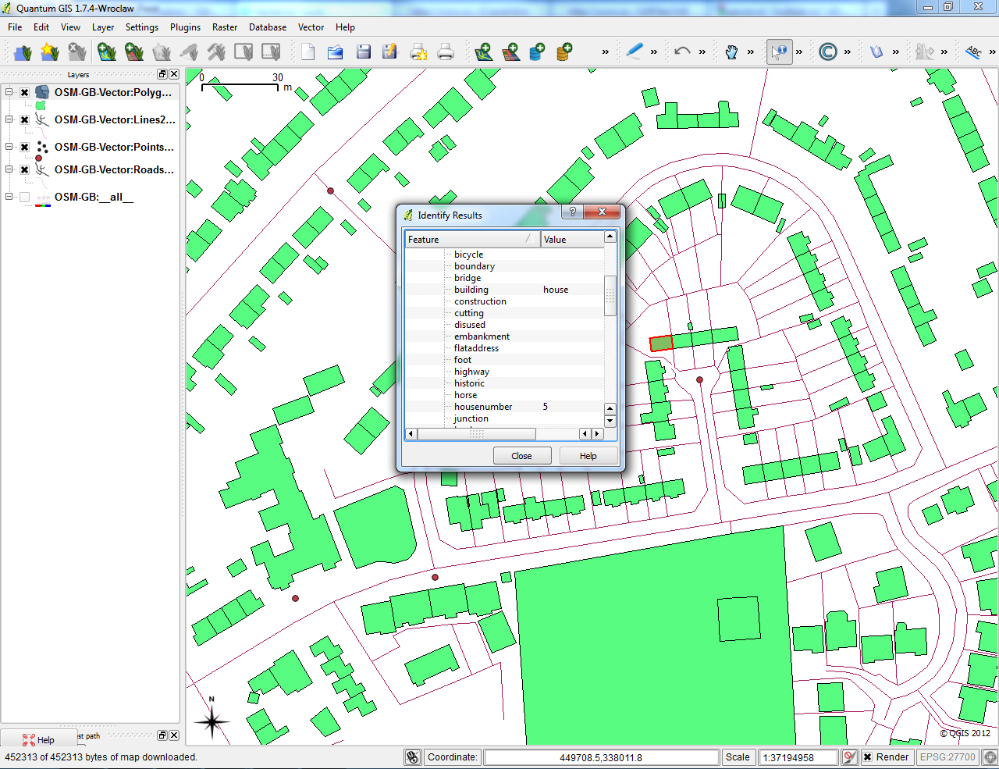
Using WMS/WFS in QGIS

Slide 14
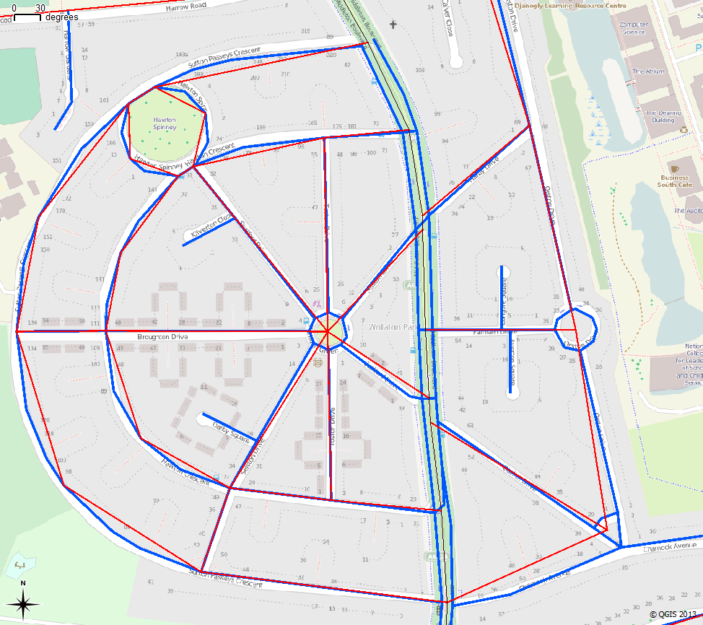
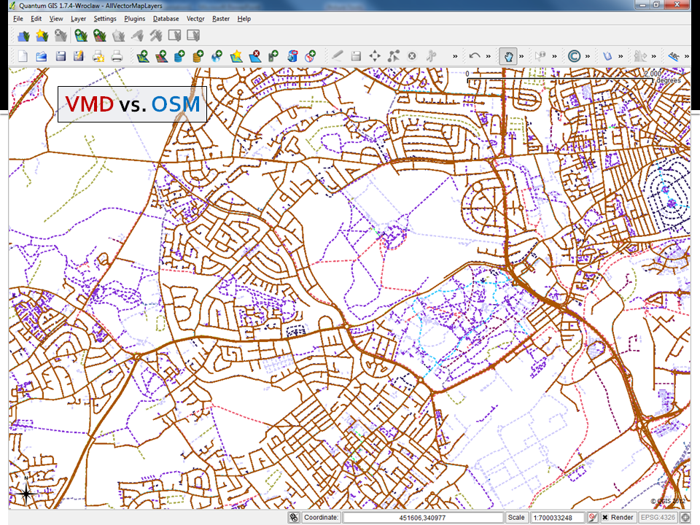
WFS for VMD
WFS for Meridian-2
WMS (OpenStreetMap)

Slide 15
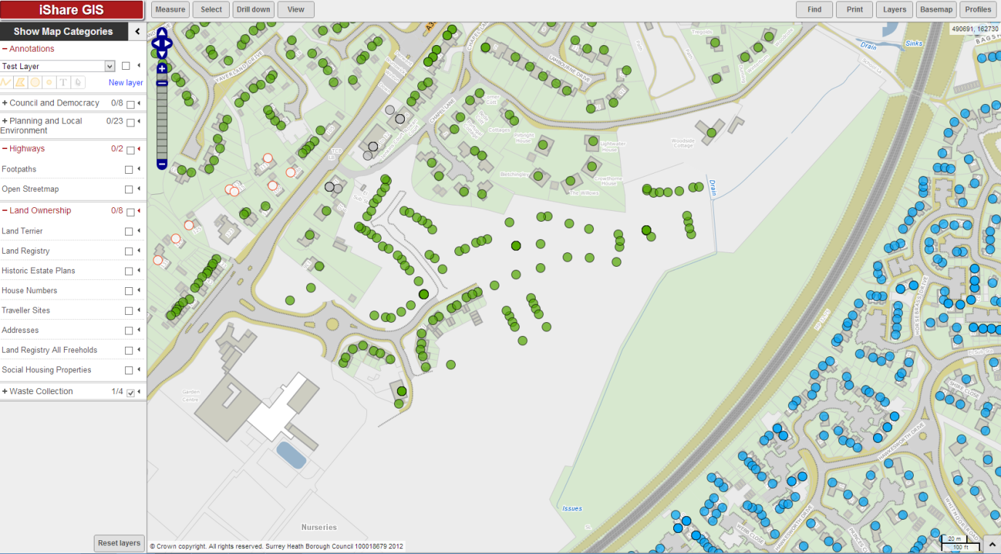
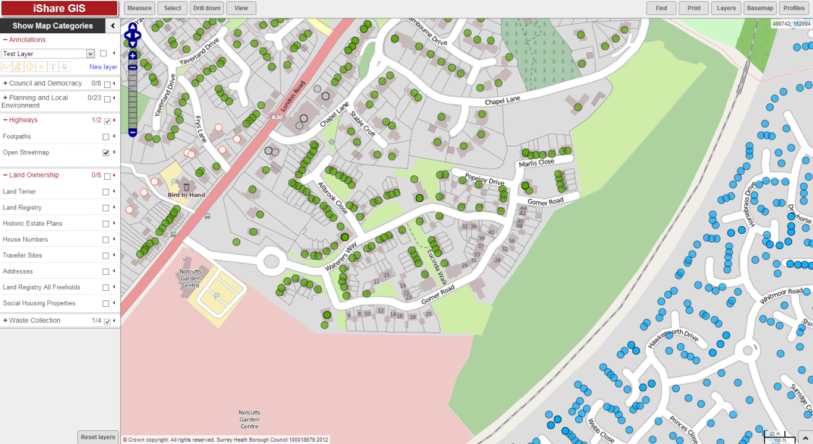
Web Services; Professional Uptake
(thanks to James Rutter)
Waste collection points on top of MasterMap
Waste collection points on top of OSMGB WMS

Slide 16
RULES and BUG Detection

Slide 17
Rules
Self Detection
Geometry bugs - Topological inconsistencies
Attribute bugs - Conceptual inconsistencies
Geometry/Attribution bugs
Mostly taken from KeepRight
Listed in http://osmgb.org.uk/osm-gb-wiki/index.php/Quality_Improvement
OSM Community
Non-standard attributes (taken from taginfo)
Differences with reference maps (OS VMD)
Mismatched features
Missing features

Slide 18
Rule-base
Lines
Dead-ended one-way | 301
Different-layer joint | 1466
Geometry/Kickback | 404 | being fixed
Geometry/Spike | 1413 | being fixed
Intersection without junction | 36940
Invalid motorway connection | 41
Mismatched road name | 2427 | fixes - currently suspended
Mismatched road ref | 366 | fixes - currently suspended
Non-standard amenity tag | 419
Non-standard building tag | 733
Non-standard highway tag | 987
Null road name | 1876 | being fixed
Null road ref | 1059 | being fixed
Overlapping roads | 637
Self-intersected line | 22178
Un-tagged bridge | 343
Unclosed Area | 2651
Wrong-level bridge | 646
Wrong-level tunnel | 200
Sum (19) | 75087

Slide 19
Rule-base – cont.
Polygons
Doubled place | 3317
Geometry/Kickback | 34 | being fixed
Geometry/Spike | 1581 | being fixed
Non-standard amenity tag | 1931
Non-standard building tag | 20510
Non-standard highway tag | 5249
Overlapping Buildings | 9736
Ways intersecting Buildings | 6876
Sum (8) | 49234
Points
Non-standard amenity tag | 3706
Non-standard building tag | 14865
Non-standard highway tag | 3480
Sum (3) | 22051
Summary
OS Missing/Mismatches | 5728
Geometry autocorrections | 3432
Invalid geometry detection | 22178
Overlapping roads/buildings | 17249
Attribution issues | 7458
Road connection issues | 38447
Non-standard tags | 51880
Sum (30) | 146372

Slide 20
Radius Studio Implementation
Read Data
Oracle Spatial
(OSM, VMD, Standard Tags, etc.
PostGIS
For All Rules
Check Rules Compliance
Apply action (Flag and/or Fix)
Commit Corrected tables

Slide 21
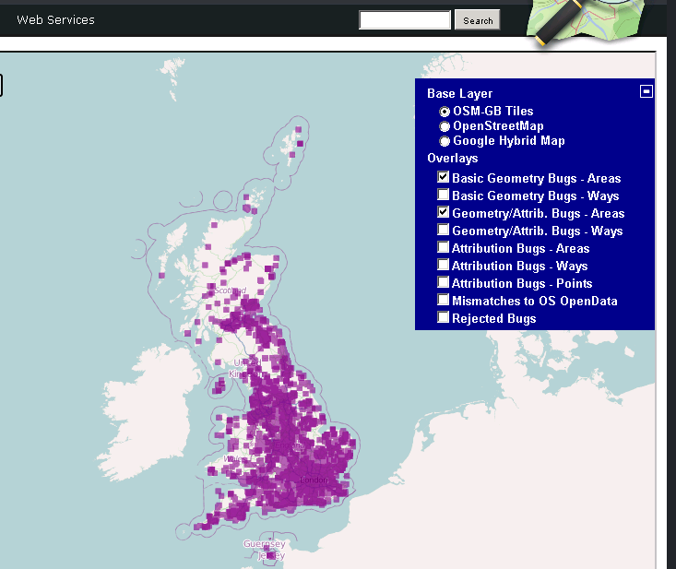
Bug Layers

Slide 22
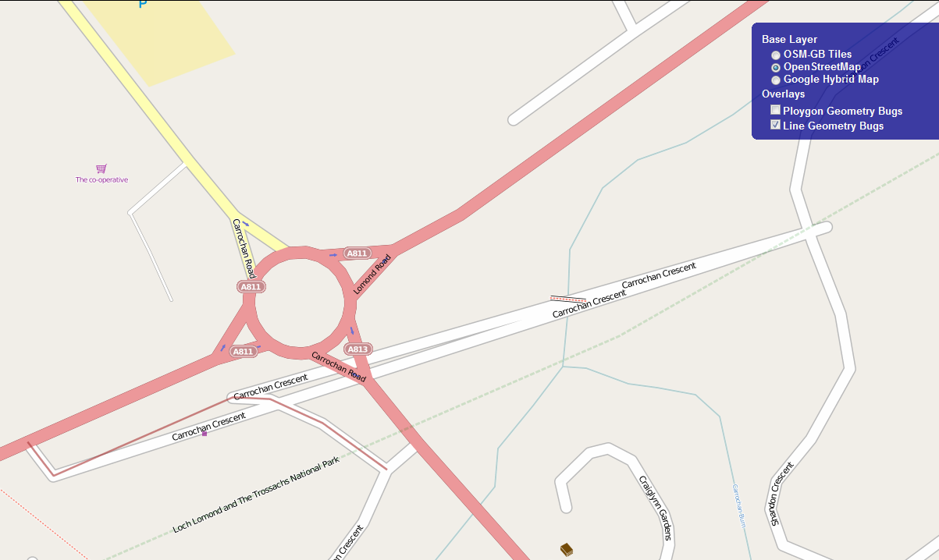
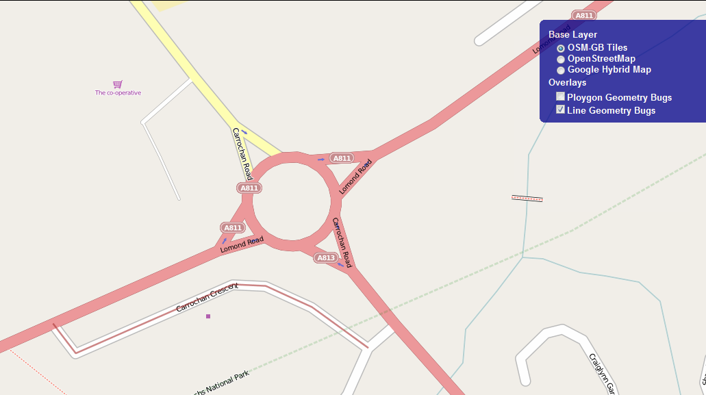
Bug Layers (Fixed)

Slide 23
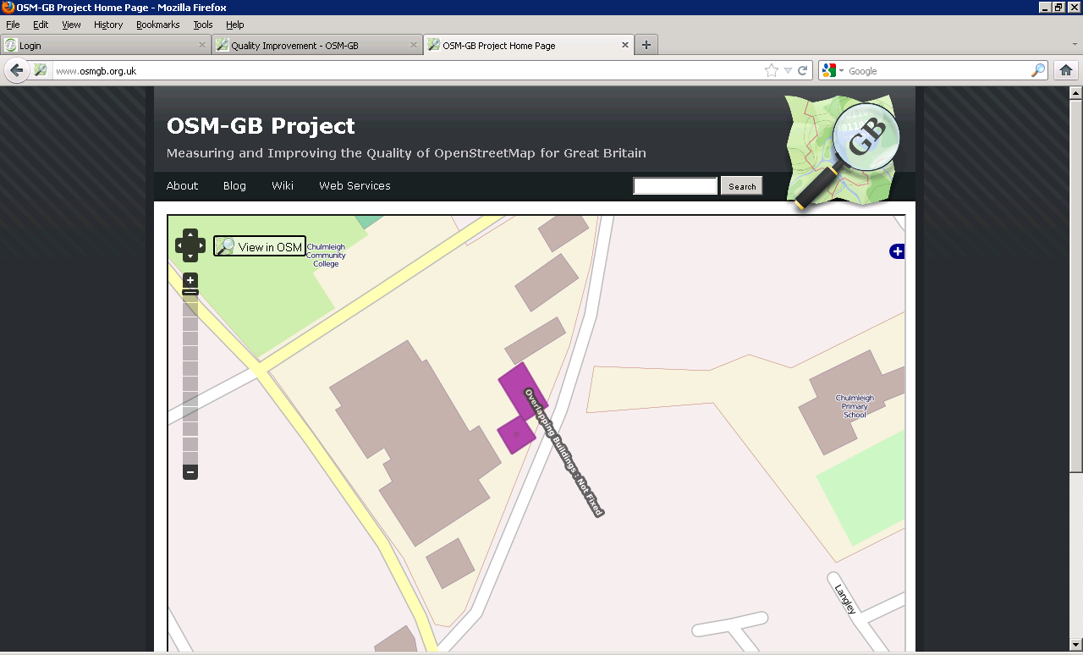
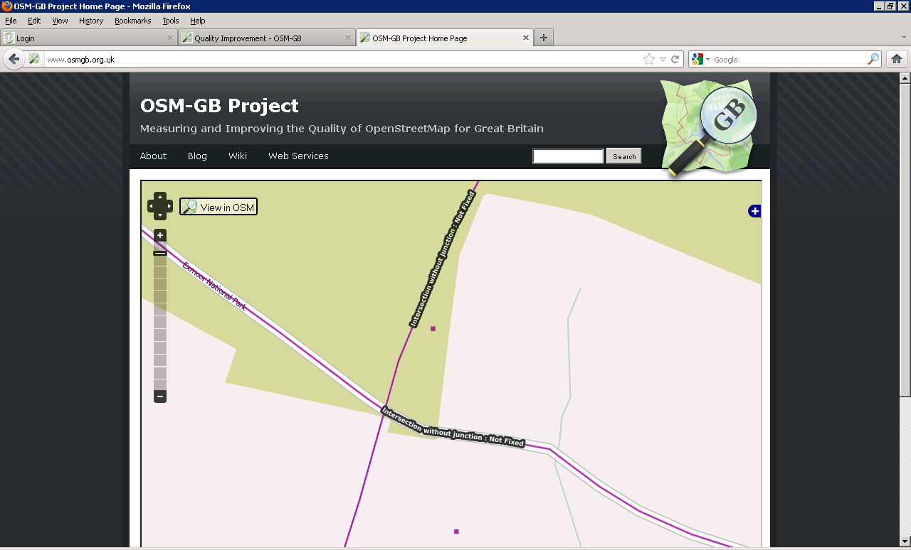
Bug Layers (Not Fixed)

Slide 24
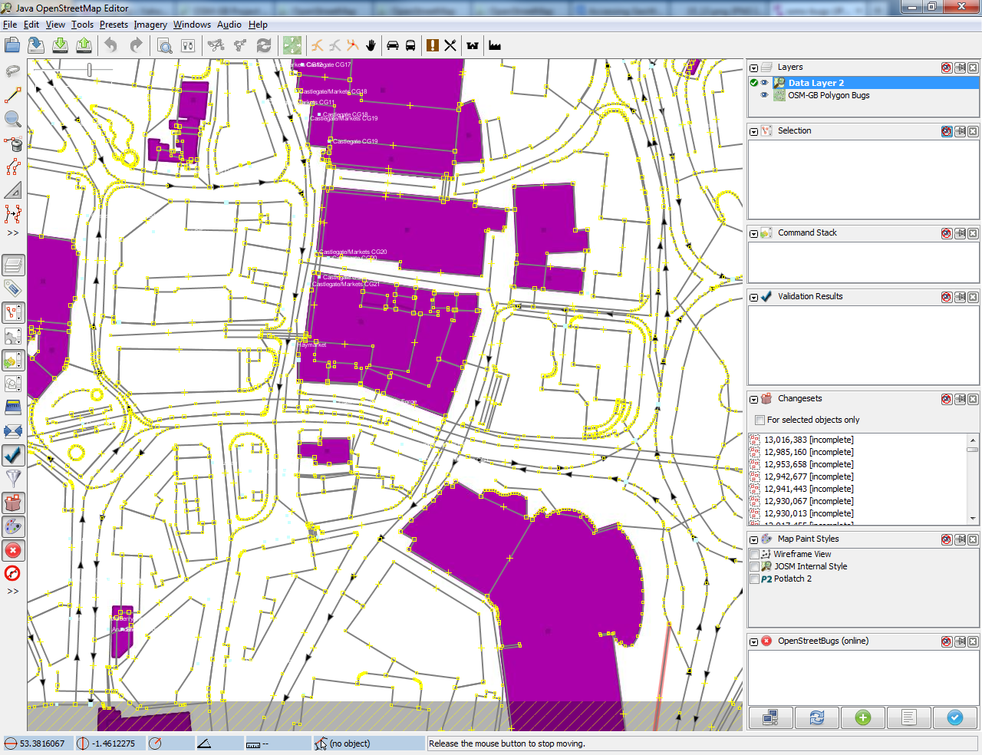
In JOSM:
Bug layers for instant corrections

Slide 25
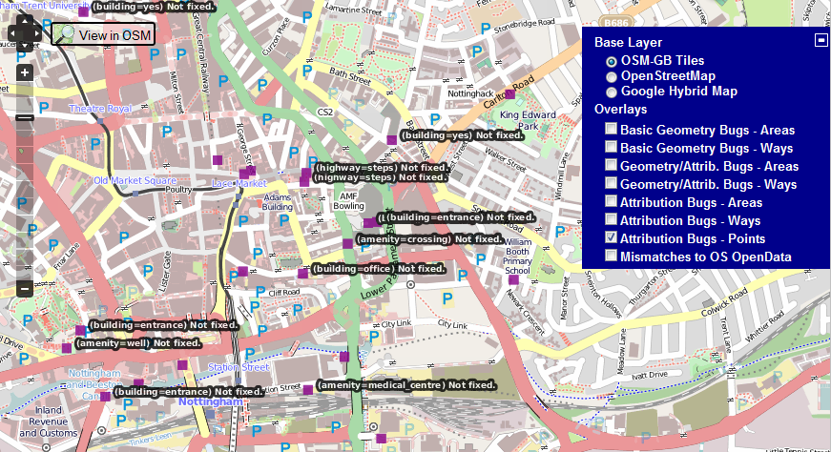
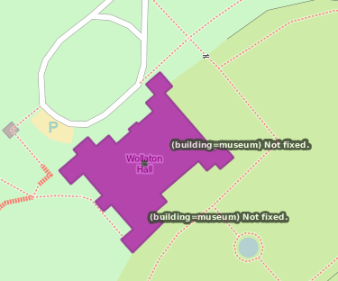
Non-Standard tagging (?)
http://taginfo.openstreetmap.org/

Slide 26
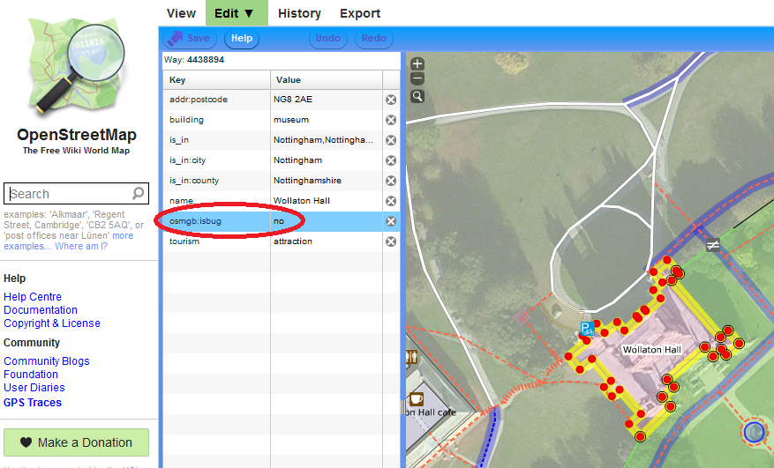
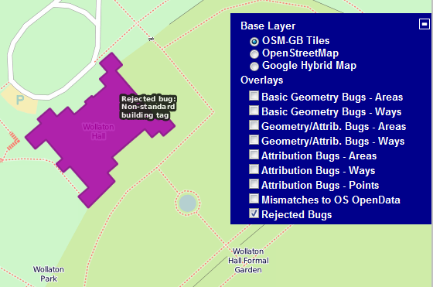
OSMGB:isbug tag

Slide 27
OSM – OS Conflation

Slide 28
VectorMap District
vs. Meridian-2
vs. OpenStreetMap

Slide 29
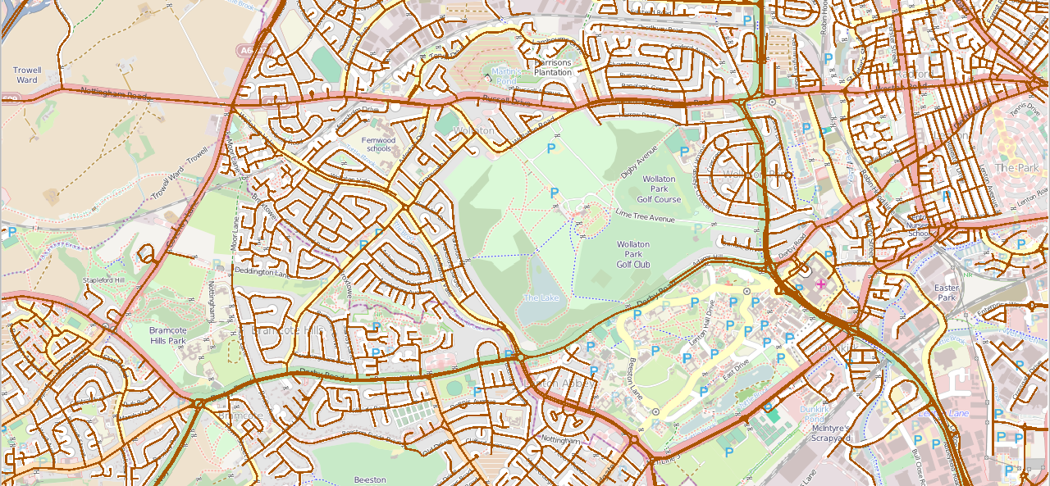
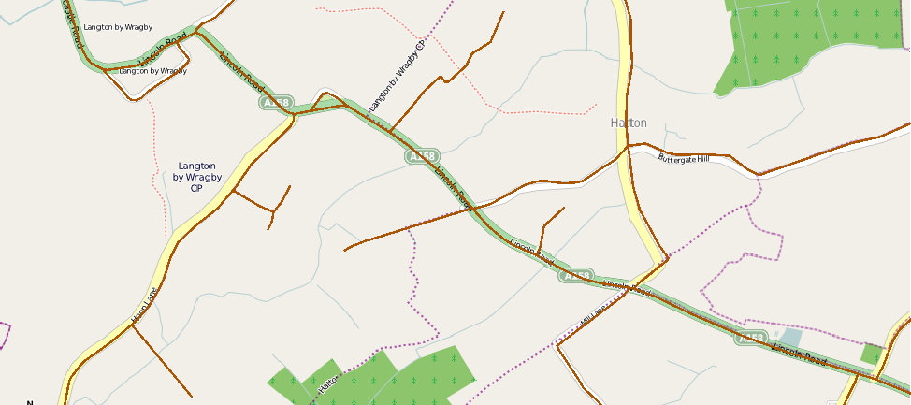
VMD vs. OSM
Urban
Rural

Slide 30
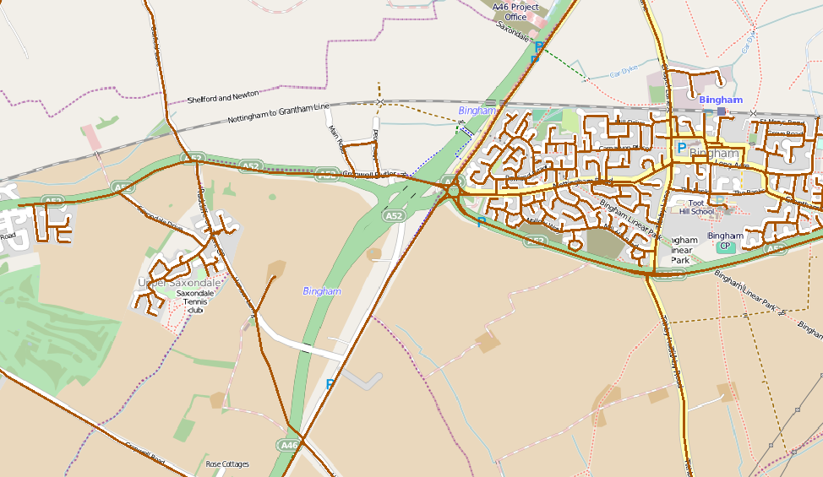
VMD vs. OSM: Update Delays

Slide 31
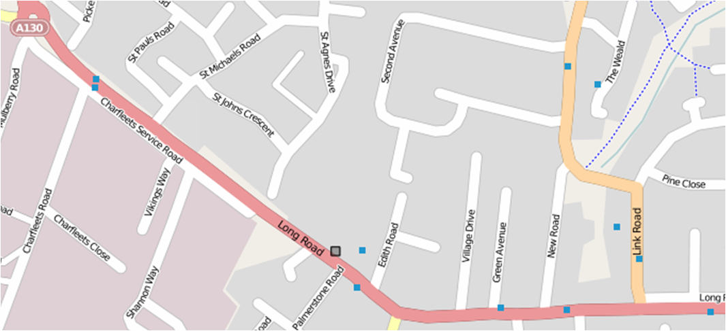
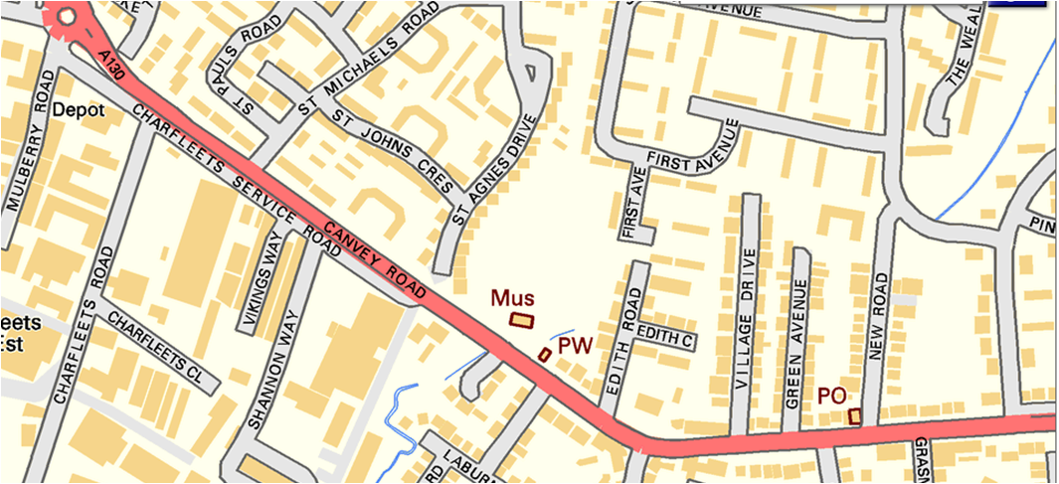
VMD vs. OSM: Road Names

Slide 32
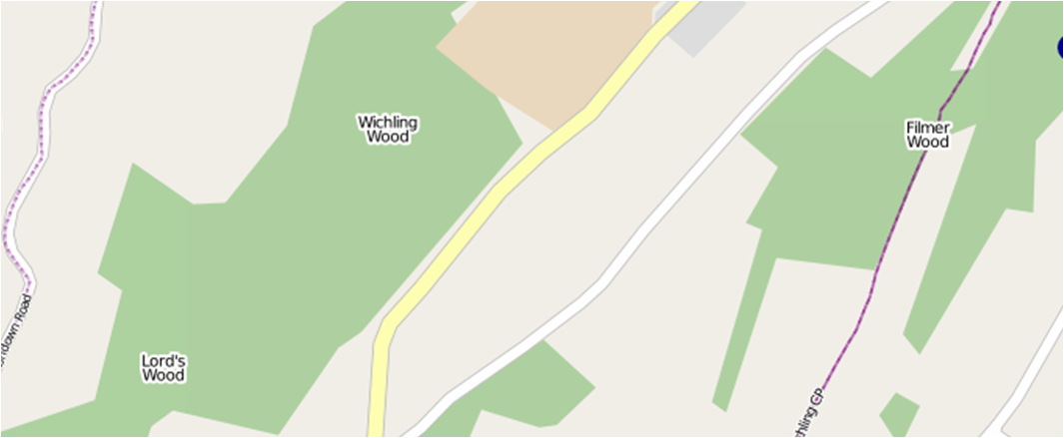
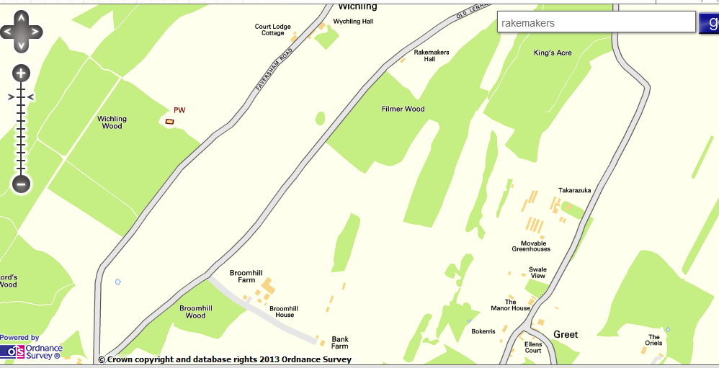
VMD vs. OSM: Road Names

Slide 33
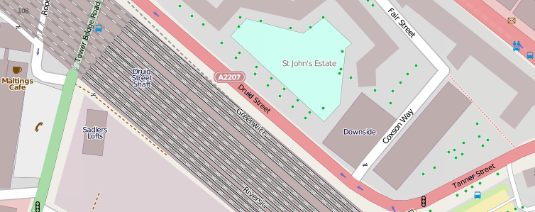
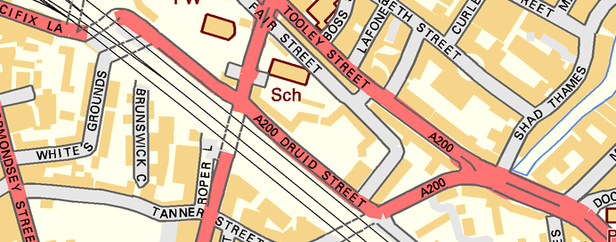
VMD vs. OSM: Road Codes

Slide 34
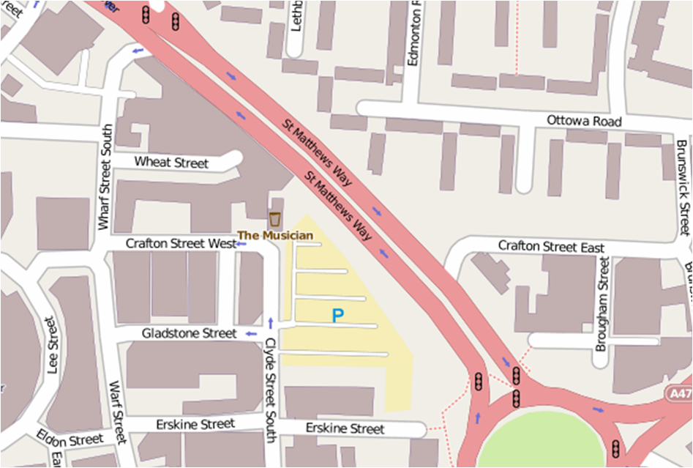
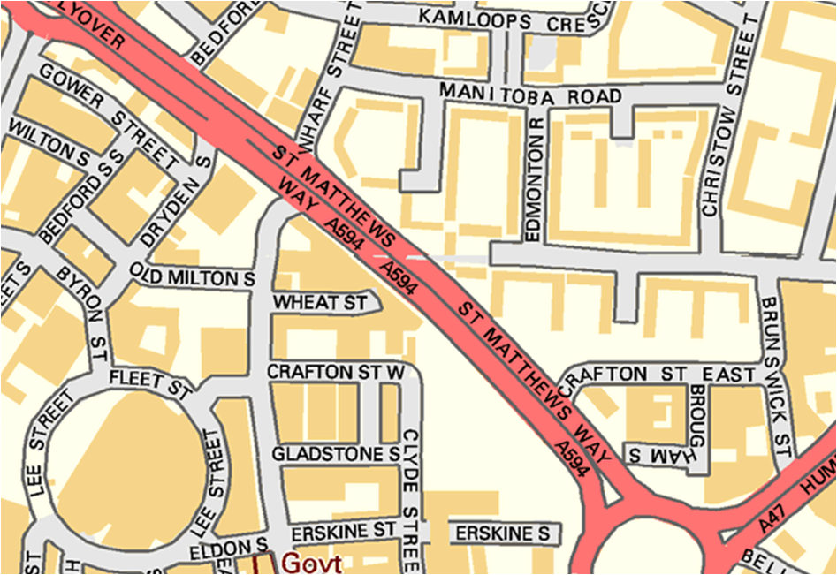
VMD vs. OSM: Road Codes

Slide 35
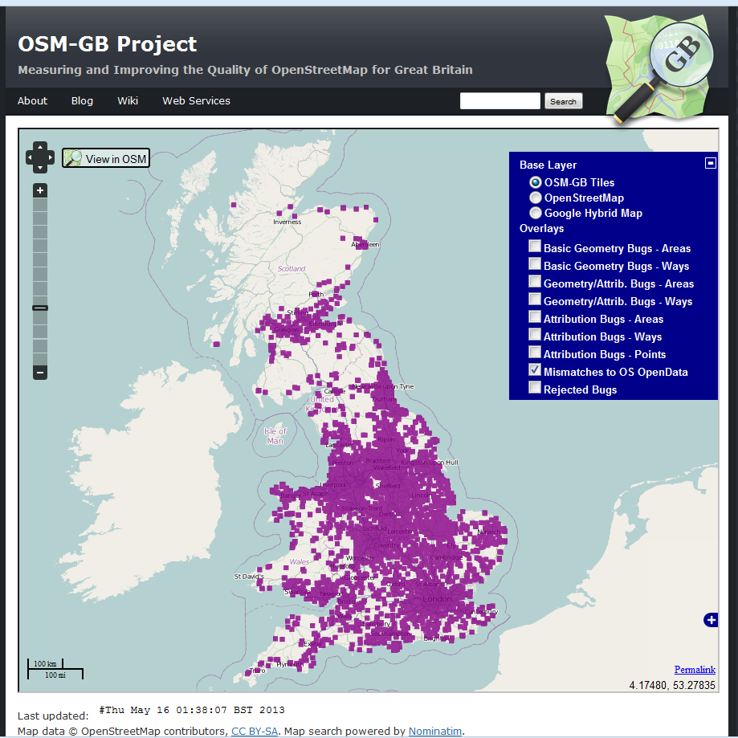
VMD vs. OSM: Road Names/Code Differences

Slide 36
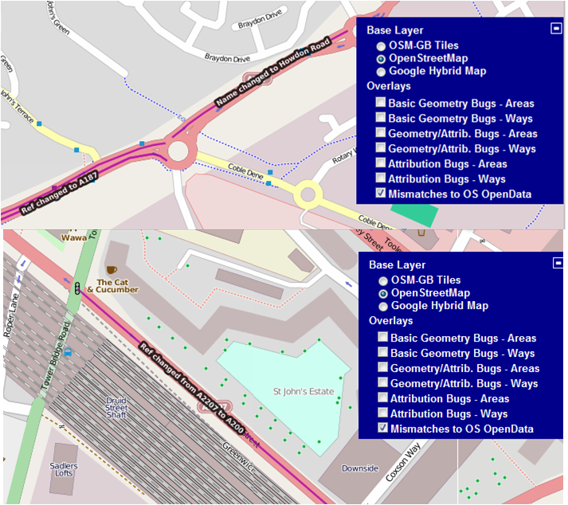
VMD vs. OSM: Automatic Addition

Slide 37
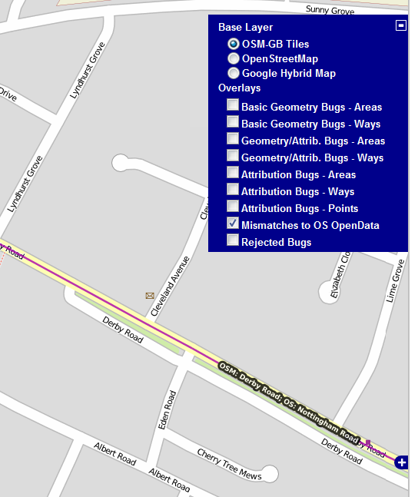
VMD vs. OSM: Flagging the Road Names Mismatches

Slide 38
OS VMD Comparison
Mismatched road names
2471
Missing road names 2026
Mismatched road refs.
377
Missing road refs.
1121

Slide 39
Patterns of road name bug ratios vs. road densities (20 x 20 km²)

Slide 40
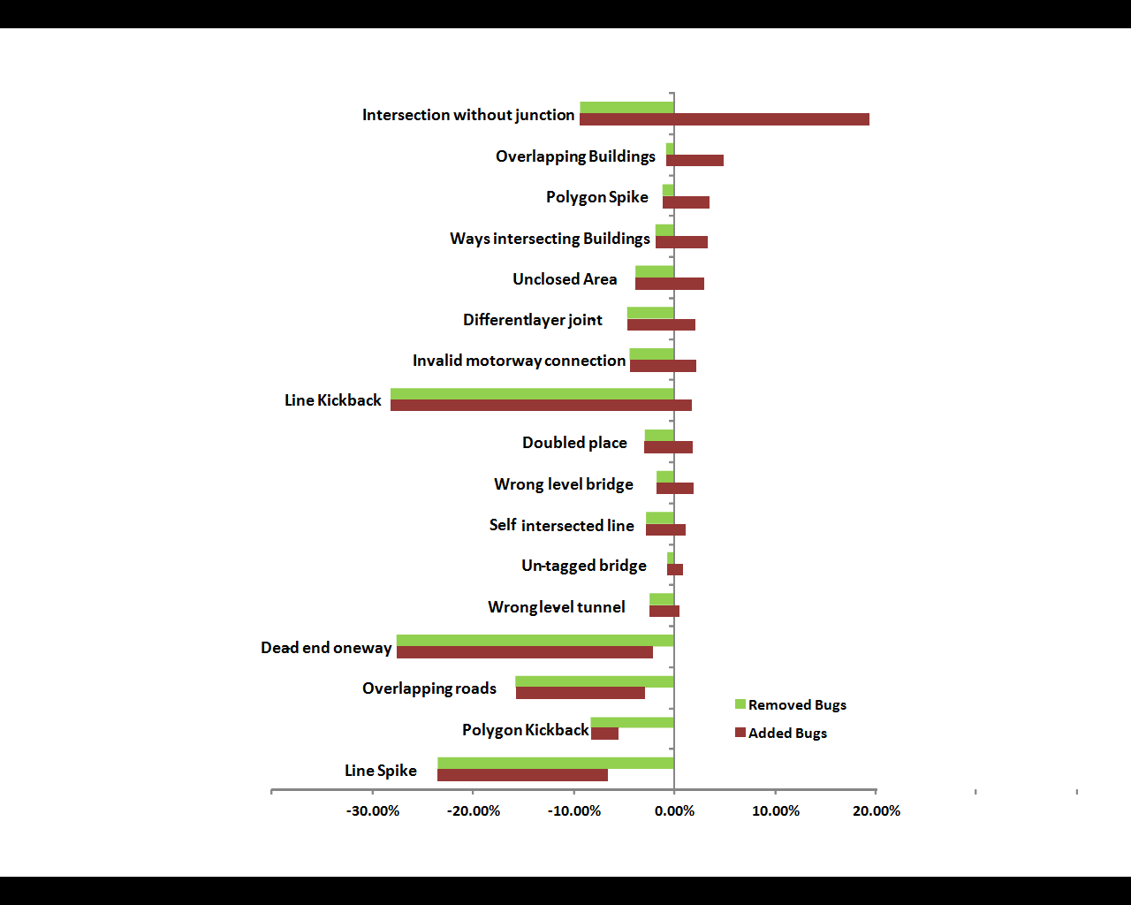
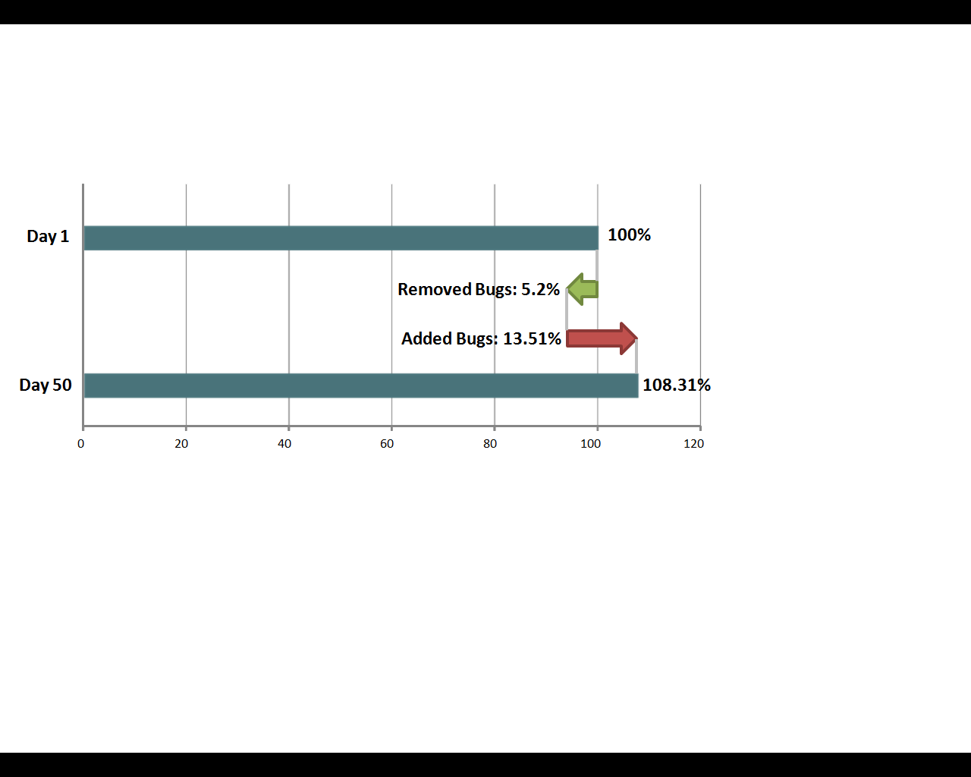
OSM Self-assessed Quality Researches

Slide 41
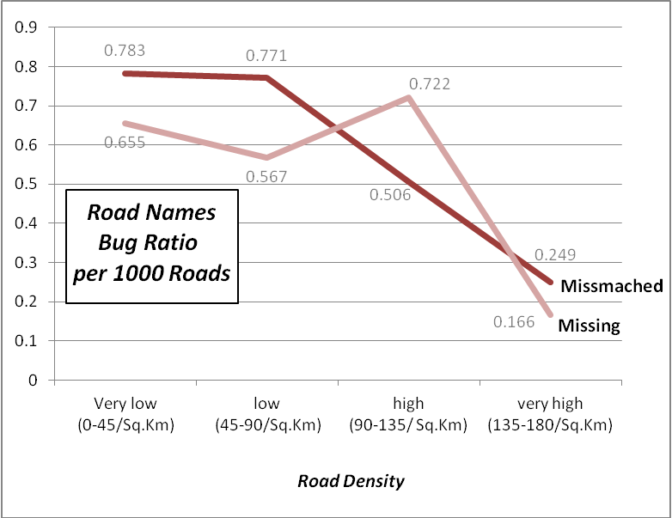
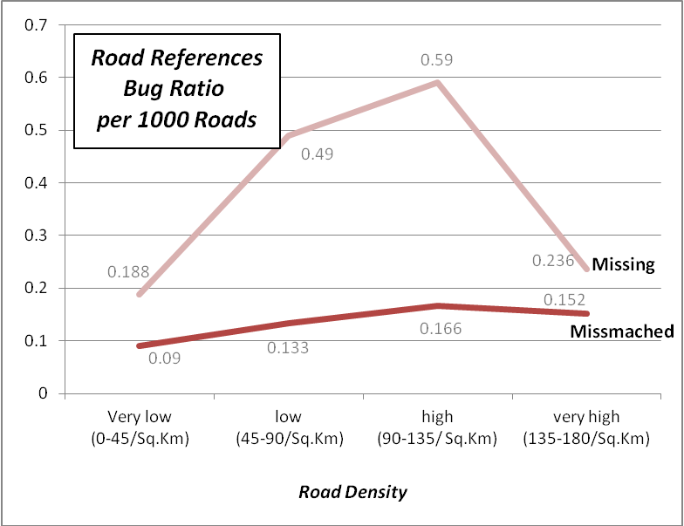
OSM/OS Reference-based Quality Researches

Slide 42
OSM Dynamicity Research
video link

Slide 43
Publications so far
Journal:
A. Pourabdollah, J. Morley, S. Feldman and M. Jackson: Towards an Authoritative OpenStreetMap: Conflating OSM and OS OpenData National Maps’ Road Network, submitted to the International Journal of Geo-Information, April 2013.
Booklet Article
Amir Pourabdollah, Jeremy Morley, Suchith Anand and Mike Jackson, An Open GIS Case Study – OpenStreetMap for Great Britain (OSM-GB), submitted to THE ISSUE-NEREUS publication titled Space and ICT Applications supporting Smart, Green, Integrated Transport and Urban Mobility, May 2013.
Conferences:
A. Pourabdollah, J. Morley, S. Feldman and M. Jackson, Studying the Dynamic Patterns of OpenStreetMap Bugs in Great Britain, the 16th AGILE Conference on Geographic Information Science, May 2013, Leuven, Belgium.
A. Pourabdollah, J. Morley, S. Feldman and M. Jackson, OSM-GB: Using Open Source Geospatial Tools to Create OSM Web Services for Great Britain, accepted for FOSS4G 2013 conference, September 2013, Nottingham, UK.
S. Feldman, A. Pourabdollah and J. Morley: OSM-GB - Can quality improvement increase contribution?, Society of Cartographers 48th Annual Conference, London, September 2012.
J. Morley, A. Pourabdollah, T. Mooney, S. Feldman and M. Iliffe: Formalizing the Crowd - applying formal quality assurance processes to OpenStreetMap, AGI GeoCommunity ’12, Nottingham, September 2012.
Workshops:
A. Pourabdollah and J. Morley, OSM-GB Workshop, the 4th Open-source GIS Conference, September 2012, Nottingham.
A. Pourabdollah and J. Morley, OSM-GB Services and Data Workshop, accepted for FOSS4G 2013 conference, September 2013, Nottingham, UK.
MSc Thesis
Chih-Yen Chang, Assessing the Data Quality of OpenStreetMap – An Examination of Overlapping Building in Great Britain, MSc in GIS, The University of Nottingham, 2012.

Slide 44
Next steps
Longer term monitoring & detailed research
Recently incorporated new rules to examine tag consistency: are features tagged with recommended combinations
Some argument from the OSM community about appropriateness of this check
Closing the feedback loop: tag “IsBug=no” to indicate a feature that is not in error
More community engagement for bug report checking & rules feedback

Slide 45


www.osmgb.org.uk
www.osm.org
www.nottingham.ac.uk/ngi
Notes:
Don’t forget to look at osmgb.org.uk

